Slide 1
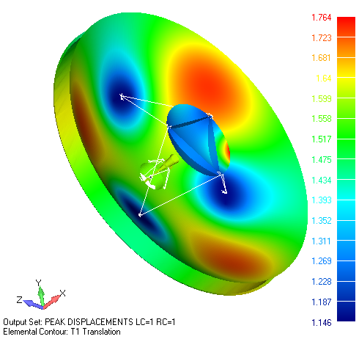
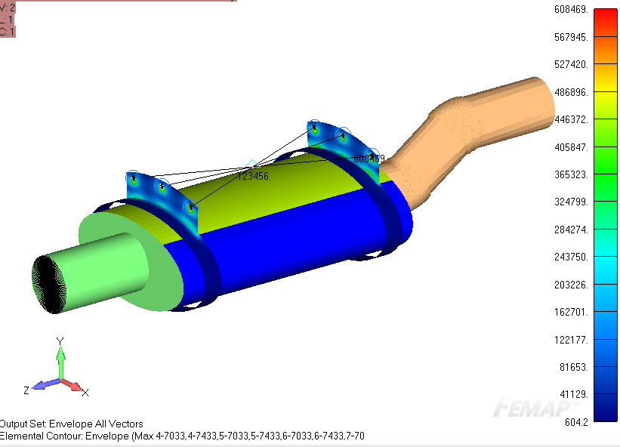
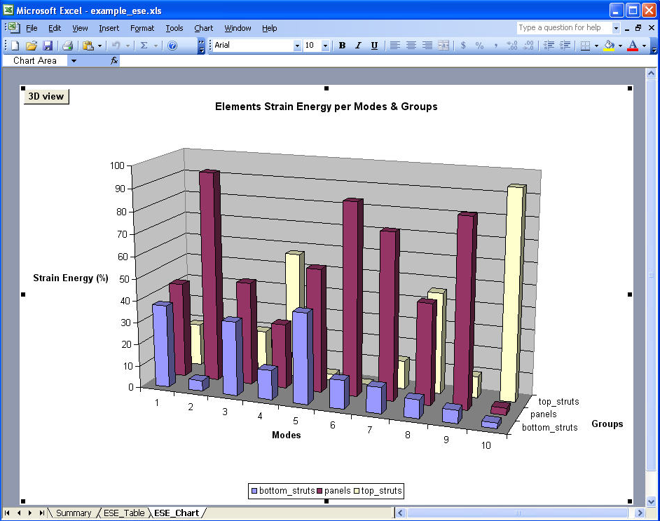
Femap Structural Analysis Toolkit (SATK)
Pierre-Luc Messier, ing.
FEMAP SYMPOSIUM 2018
May 22nd 2018

Slide 2
Agenda
Structural Analysis Toolkit Overview
Random Processor & Demo
Energy Processor & Demo
Questions and Discussion

Slide 3
Agenda
Structural Analysis Toolkit Overview
Random Processor & Demo
Energy Processor & Demo
Questions and Discussion

Slide 4
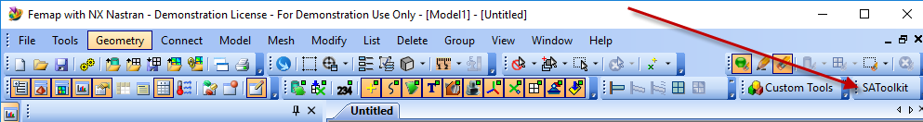
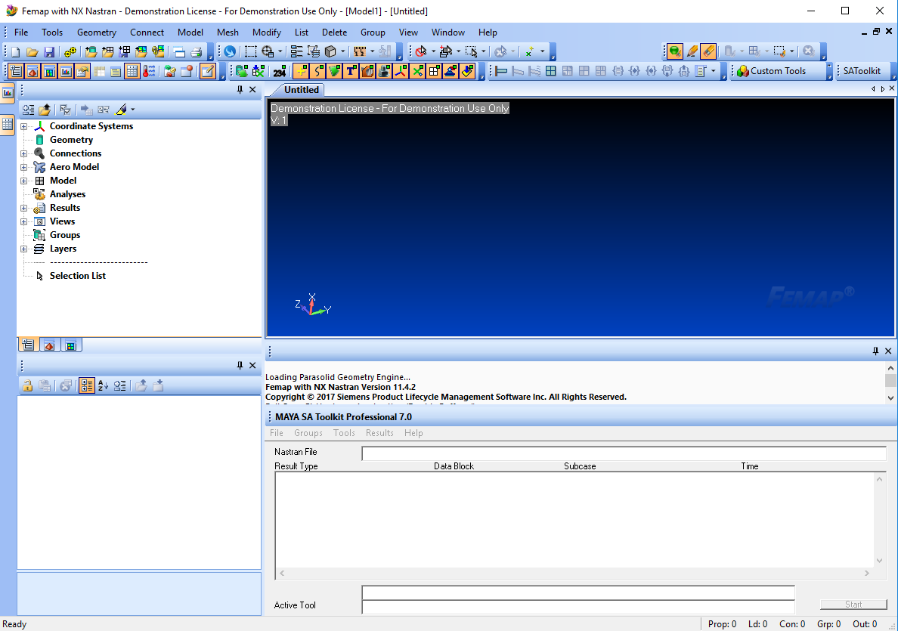
Overview - SATK Femap Interface
Notes:
Embedded inside Femap

Slide 5
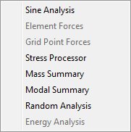
Overview - SATK Femap Interface
Tools
List of tools you can use with the selected OP2 file
Active tools depend on datablocks available in OP2 file
If Quick Open was used, it is your responsibility to select the proper tool

Slide 6

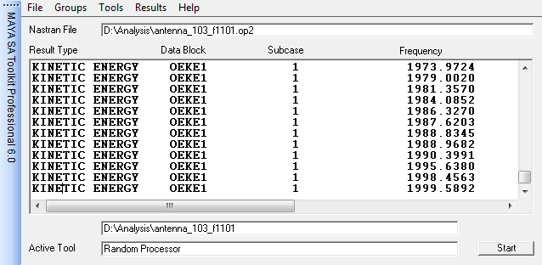
Overview - SATK Femap Interface
Quick Open
Does not scan the OP2 file
Enables all processors except Stress, Grid Point Forces and Element Forces because they require subcase information
Opening a new file overwrites the current settings
Open
Select the NASTRAN OP2 file to process
Scanned datablocks are displayed in main form window
Opening a new file overwrites the current settings
Set Project
Define the project directory and prefix name of all results files
By default, the OP2 directory and name are used

Slide 7
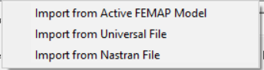
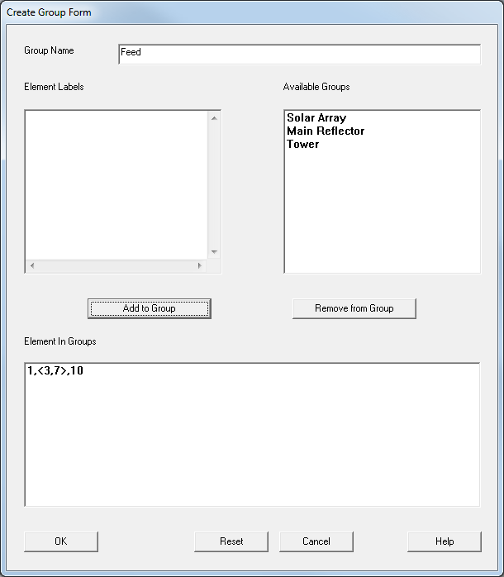
Overview - SATK Femap Interface
Import from Active FEMAP Model
Only nodes and elements are retrieved
Groups with nodes AND elements will be split
Imported groups cannot be modified, but can be copied
When groups have identical names, only the first occurrence is imported
Import from Nastran File
Reads the SETs
Automatically determine the entity type
Can automatically find the group name
Import from Universal File
Datasets: 2435, 2452, 2417, 2467, 2477, 3062

Slide 8
Overview - Benefits
Efficient and accurate random and sine base-driven solutions from NASTRAN normal modes
  Processes very large models
  Tools to understand the modal behavior of complex assemblies
Efficient post-processing of Nastran results
  Sorts, envelops, filters
  Summaries by groups and subcases
  Margins of safety from Von Mises stresses, ply failure metrics
Direct manipulation of .OP2 file
  No need to load large results files into graphical post-processor

Slide 9
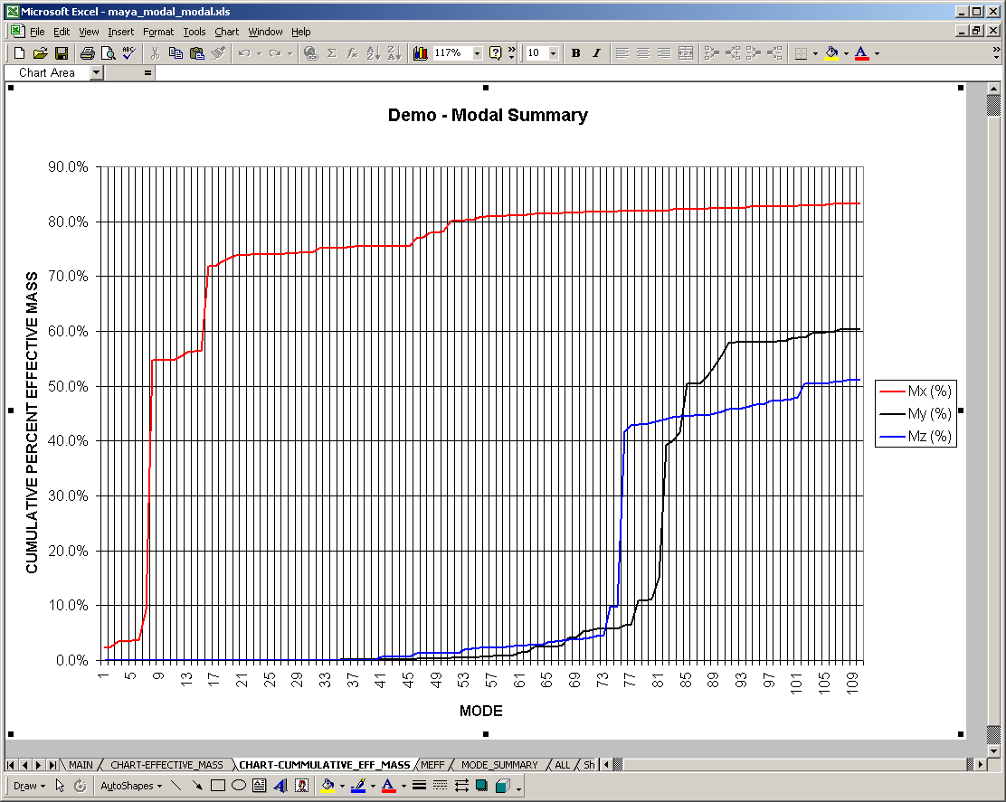
Overview - Compatibility
Supports NX & MSC Nastran
Windows & Linux platforms
SAToolkit contours can be post-processed in FEMAP
HTML, MS Excel®, text automatic report generation

Slide 10
Agenda
Structural Analysis Toolkit Overview
Random Processor & Demo
Energy Processor & Demo
Questions and Discussion

Slide 11
Random Processor - Overview
It reads results of normal modes (SOL 103) analysis and evaluates responses of a structure subjected to a random base driven acceleration
Earthquake ground motion
Acoustic excitation due to rocket and jet engine noise
Using an efficient modal approach, it replaces all steps following the initial NASTRAN normal modes solution (sol108 and sol 111)

Slide 12
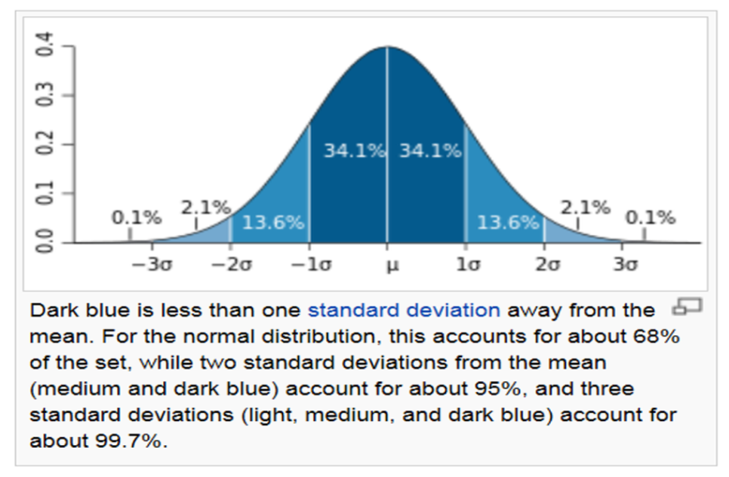
Random Processor – Feature Overview
Statistics are required to assess the probability of the response’s magnitude
  Random theory assumes that the input follows a Gaussian distribution.
  The same assumption applies to the response
Source: Wikipedia

Slide 13
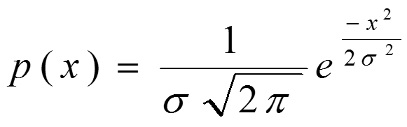
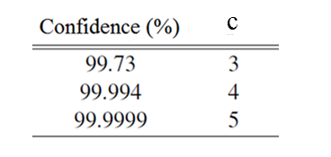
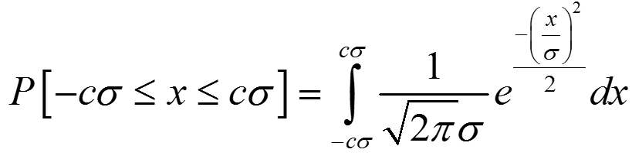
Random Processor – Feature Overview
Zero mean Gaussian probability density function
Peak value of x is Peak = c * RMS
The probability of x lying in the interval –cσ and +cσ where c > 0.0:

Slide 14
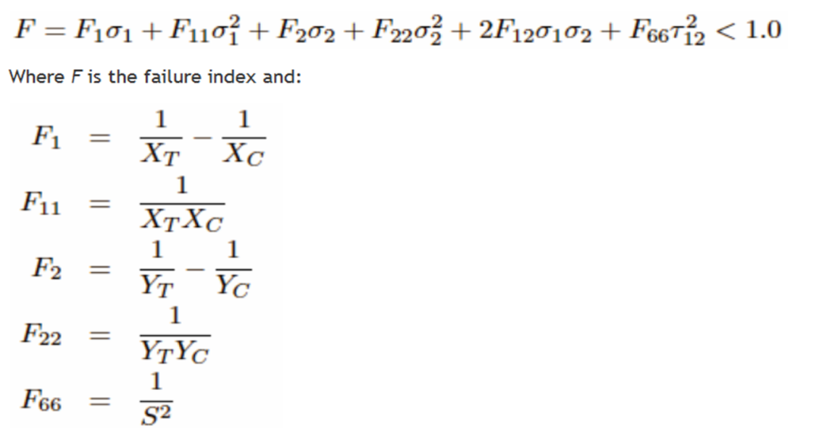
Random Processor – Feature Overview
Examples of response quantities that do not follow Gaussian distributions
Von Mises Stress
Tsai-Wu composite failure index

Slide 15
Random Processor – Feature Overview
For response quantities that do not follow Gaussian distributions:
Relationship between probability density function and standard deviation sigma no longer holds
Hence it is not meaningful to express the peak results as a function of the standard deviation, for example 3-sigma
To evaluate response quantities that do not follow Gaussian distributions, numerical approximations are required.

Slide 16
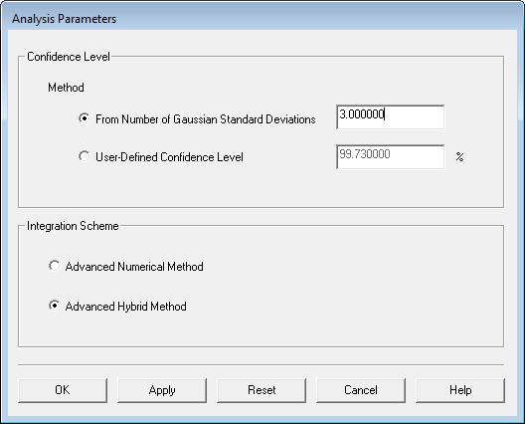
Random Processor – Feature Overview
True peak stresses and failure metrics based on a confidence level that is either:
  Directly specified, or
  Equivalent to a specified standard deviation for a
  Gaussian probability density function
      eg 99.73% = 3 sigma
  No need to scale RMS results

Slide 17
Random Processor – Feature Overview
High-performance integration algorithm
  Does not require frequency card (FREQ) definition
    You won’t have to worry about defining too few or too many
    Avoids the risk of error by under-specification of number of computation frequencies
    You only need to supply the minimum and maximum frequency bounds for the simulation

Slide 18
Random Processor – Benefits
Fast Processing
Efficient OP2 reader
Fast approximation
Parallelization
Hybrid integration
Analytical where possible
Only integrates on a subset of the responses
Output direct to NX/FEMAP, Excel
Accuracy
Uses Nastran eigenvectors
Residual flexibility/Residual vectors
Integration scheme does not force you to define solution frequencies
Evaluation of peak Von Mises stress and composite failure metrics

Slide 19
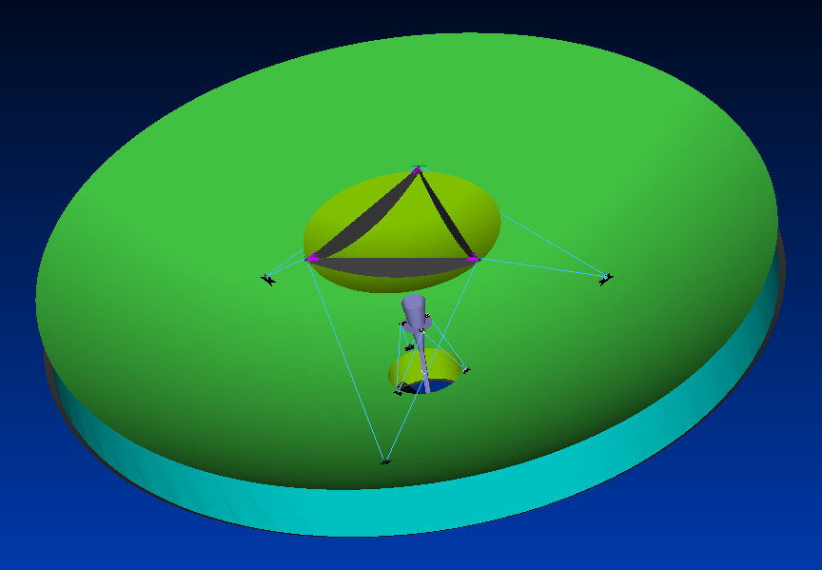
Random Processor - Demo
Antenna

Slide 20
Femap Structural Analysis Toolkit
Structural Analysis Toolkit Overview
Random Processor & Demo
Energy Processor & Demo
Questions and Discussion

Slide 21
Energy Processor – Overview
Energy processor offers 2 criteria that can help in understanding modal behavior :
Strain energy
Can help to identify regions in your model that can be modified to yield the biggest changes in modal results.
Kinetic energy
Can help to identify regions with a combination of high responses and participating mass. Can be used to evaluate candidate locations for accelerometers in modal or vibration tests.
Similar to Random processor, the Energy processor reads information from a normal modes analysis. FEMAP groups can be imported into the processor. Critical modes and groups, in which strain and/or kinetic energies are high, can easily be identified in the processor's Excel output.
Notes:
Kinetic
Strain energy
Provides a thorough understanding of modal behavior in assemblies

Slide 22
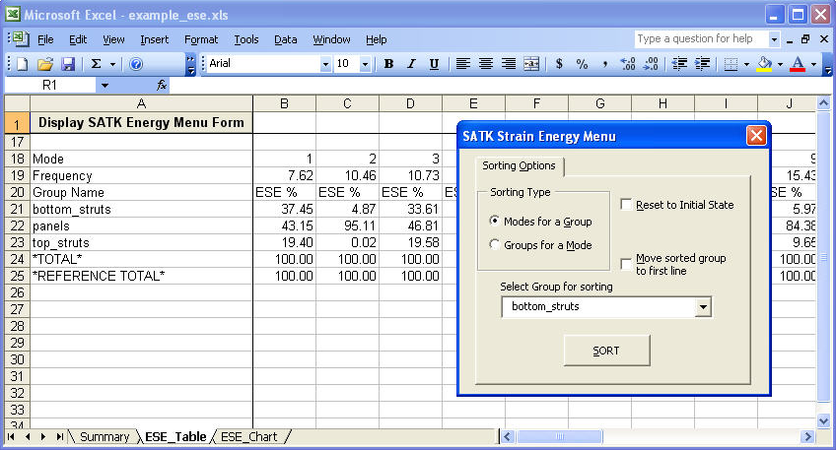
Energy Processor - Overview
Critical modes and groups, in which strain and/or kinetic energies are high, can easily be identified in the processor's Excel output.

Slide 23
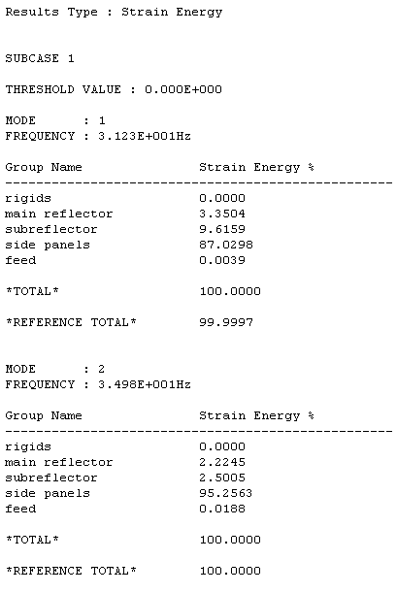
Energy Processor – Overview
Reference Total is the total modal energy for all elements in the model
Should be as close as possible to 100.0 %
This depends on THRESH / TINY
Total depends on the elements in your groups
If you have duplicates, it may easily exceed 100.0 %

Slide 24
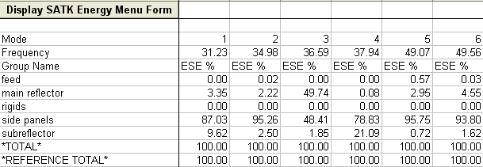
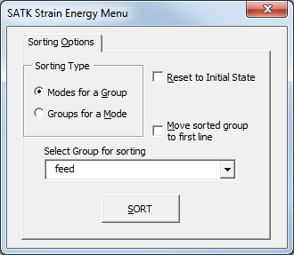
Energy Processor – Overview
Menu available for Groups only Output Option
Modes for a Group lists modes with the highest energy in decreasing order, from left to right, for the specified group
Groups for a Mode lists groups with the highest energy in decreasing order, from top to bottom, for a specified mode

Slide 25
Energy Processor - Demo
Antenna

Slide 26
Femap Structural Analysis Toolkit - Summary
Advanced post-processing capability for Nastran analyses
Efficient, state-of-the-art analytical tools for conducting Nastran modal-based response dynamics simulation
        ½ Day training available
Notes:
What to remember:
SATK Random Processor is unbeatable as for
efficiency in calculation (FAST)
accuracy of peak Von Mises stress and composite failure metrics

