Slide 1
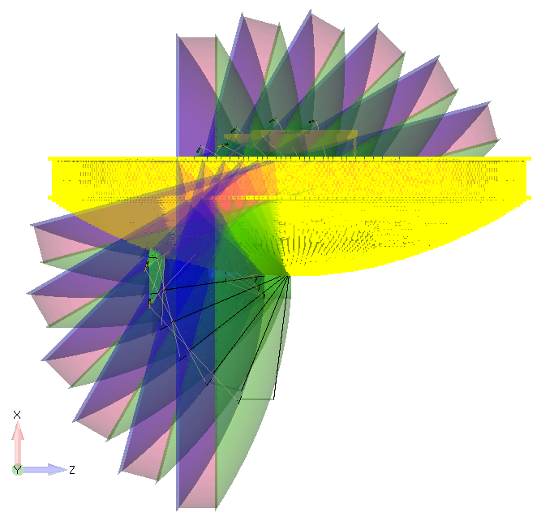
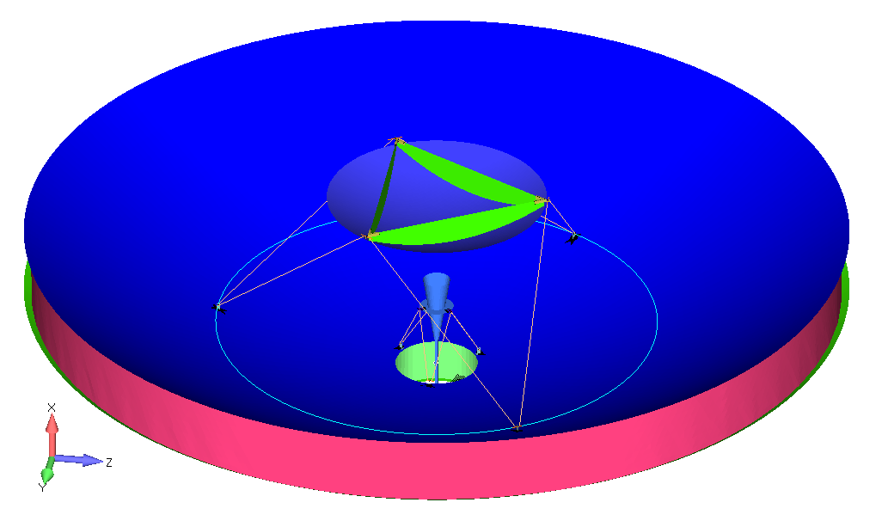
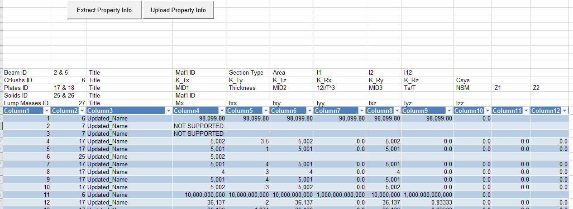
Femap API Introduction
Pierre-Luc Messier, ing.
B
A
C
FEMAP SYMPOSIUM 2018
May 22nd 2018

Slide 2
Agenda
API Overview
API vs Program File
Why use API?
API Programming Interface
The Type Library
Resources
Demo 1: Create user commands and keyboard shortcuts
Demo 2: Drive Femap from Excel (extract from Femap to Excel, modify in Excel, then update to Femap)
Example 1: Path Length calculation on an antenna dish
Example 2: Calculate in-plane displacements

Slide 3
Overview - Application Programming Interface (API)
Femap provides a robust set of finite element modeling and post-processing functionality.
Femap API lets you customize Femap to meet your specific needs.
Femap API is an OLE/COM-based programming interface to Femap. It contains hundreds of functions that can be called from Visual Basic, VBA, C, or C++.
This allows Femap to become a powerful integration program for third party solutions (Excel, Word, Matlab, SolidEdge, Catia, ... ) and significantly increases the portability of data into and out of the program.
Many useful programs are delivered with Femap in an ever expanding library that can be found in the Custom Tools toolbar. Code is provided!
Notes:
FEMAP includes development environment that allows for the creation of custom programs to extend and enhance FEMAP functionality
Programs can be scripts or stand-alone programs
FEMAP can be viewed as a development platform
Out-of-the-box functionality may fit the FEA needs of 95% of the users 95% of the way
It’s not possible to be a perfect Pre-Post for everyone
Different companies / people have different FEA needs
Each company has their own methods of doing analysis
Each individual within a company may have their own style

Slide 4
Overview - Femap API
“Our goal is to use Femap and its API to eventually automate the model development process, reducing the time by half through the use of templates, automation and improved access to CAD information.”
Glenn Harris, EADS Astrium Satellites UK
Notes:
Custom user interfaces can be created and used with FEMAP programs
Simple custom dialogs an be created in the API Programming Window
More complicated dialogs or programs can be created as separate programs and used as FEMAP add-ins
Programs can range in complexity from basic scripts to add-ins / standalone programs

Slide 5
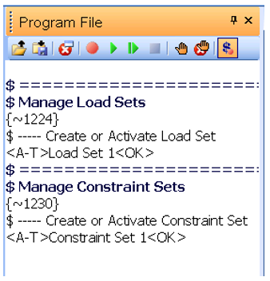
API vs Program Files
As well as the API, Femap also offers a macro capability (program) that allows a series of commands to be recorded, edited and debugged, and played back. This way, you can create custom programs that automate repetitive tasks.
Common usages:
Repetitive sequences of commands can be recorded and played back.
Program File macros are easily created by the non-programming engineers.
Program files can be modified to accept user input and executed from API scripts.
Notes:
Program Files (PRG) are a mouse and keystroke emulator.
PRG is similar in functionality to the MS Office macro recorder
Benefits
Simple to create
Can emulate all functionality
Drawbacks
Customization is very difficult
Slow
Very limited potential
Unlikely to remain compatible between major versions

Slide 6
Why use API?
Ultimately, this is what we want:
…but we all know that this is utopic.

Slide 7
Why use API?
Real benefits:
Automate routine tasks
Interact with model data in ways that are not natively available
Provide “canned” analysis routines
Ensure consistency in analysis methods between engineers by providing a consistent method
Enhance the functionality of FEMAP by creating add-in applications
Automate generation of analysis reports
Reduce the learning curve for newer users
Integrate FEMAP with existing methods
Modify results data
Create nodes from a CSV file
Create a custom meshing algorithm
FEMAP Add-ins can also be created that behave like standard dockable panes
Notes:
These are the benefits

Slide 8
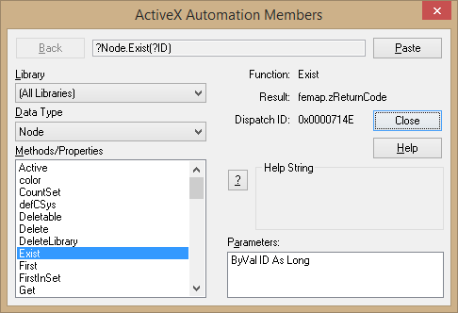
API Programming Interface
Full-featured BASIC programming environment inside the UI
IntelliSense function descriptor auto completion
Step through interactive program debugging
Syntax Highlighting
Object Browser
Debugging
Debugging – Additional toolbar

Slide 9
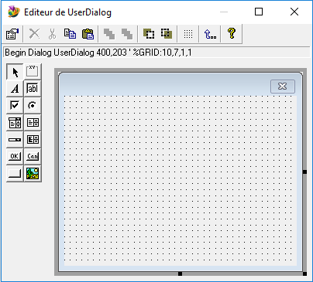
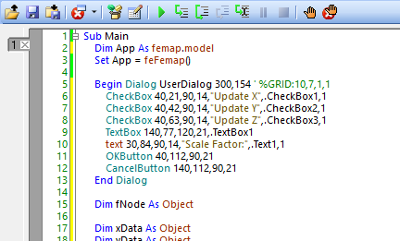
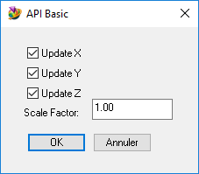
API Programming Interface
Full-featured BASIC programming environment inside the UI
Custom User Dialogs Editor

Slide 10
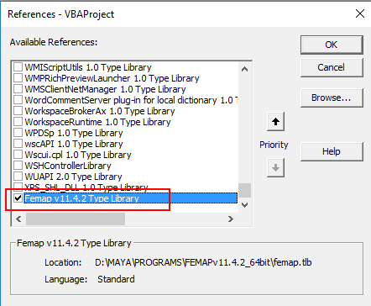
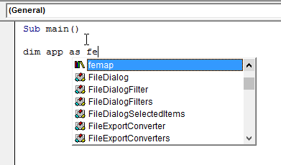
Type Library

Slide 11
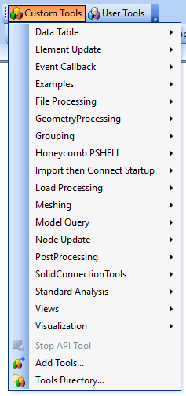
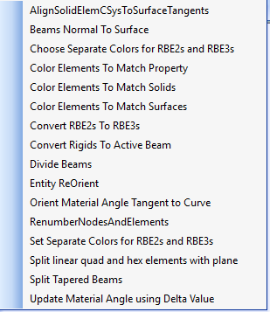
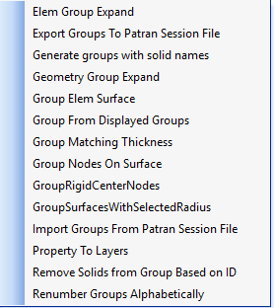
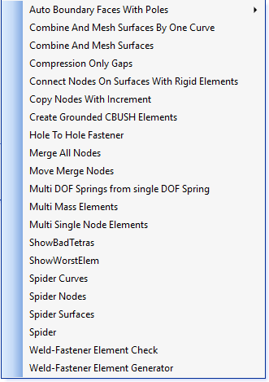
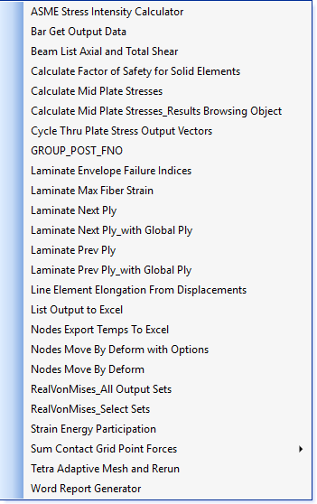
Ressources – Custom Tools
Element Update
Grouping
Meshing
PostProcessing
Notes:
Show list in Femap
Talk about most useful tools
Hole to Hole Fastener

Slide 12
Resources – Custom Tools
All Custom Tool commands are documented in FemapInstallDir/pdf/CustomTools.pdf
Most useful tools
Element Update - Divide Beam
Grouping - Group expand
Meshing - Hole to Hole Fastener
Model Query - Multi Dependent Rigid Check
PostProcessing - Nodes Move by Deform with Options
View - View Swap

Slide 13
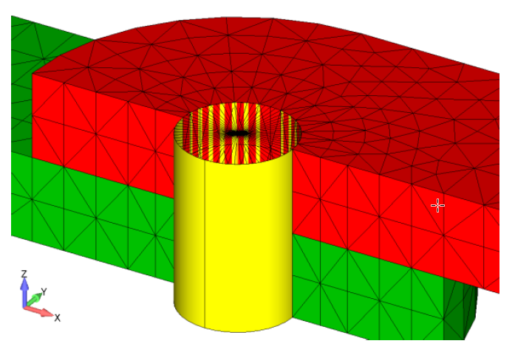
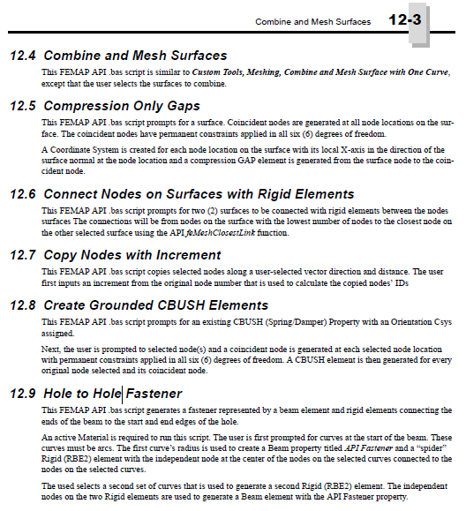
Resources – Custom Tools
All Custom Tool commands are documented in FemapInstallDir/pdf/CustomTools.pdf
Meshing - Hole to Hole Fastener
Notes:
Adjust the

Slide 14
Resources - Custom Tools
Model Query - Multi Dependent Rigid Check
Notes:
Adjust the

Slide 15
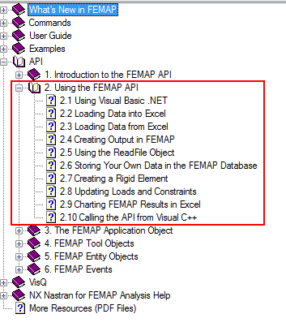
Resources – Help and Examples
FEMAP API Reference Manual found in
Help->Programming or
<FEMAP ROOT>/pdf/api.pdf
Include basic examples of API programs
Notes:
Adjust the

Slide 16
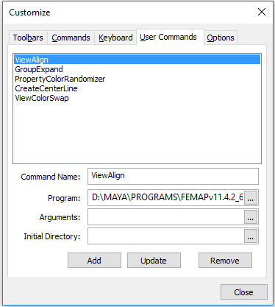
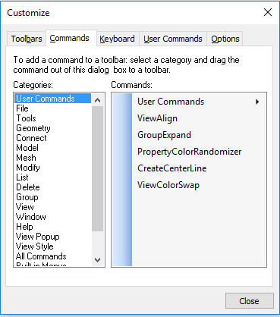
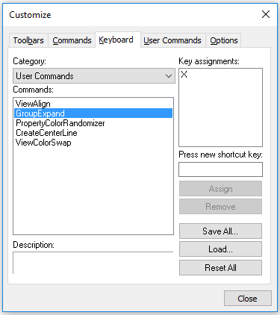
Demo 1
Create
User commands
Keyboard shortcuts
New toolbar and button
Notes:
TELL - SHOW

Slide 17
Demo 2
Drive Femap data from Excel
Extract material and property data from Femap to Excel, update/calculate/validate values in Excel, then upload back to Femap
Notes:
(Opt) Deeper look inside code.

Slide 18
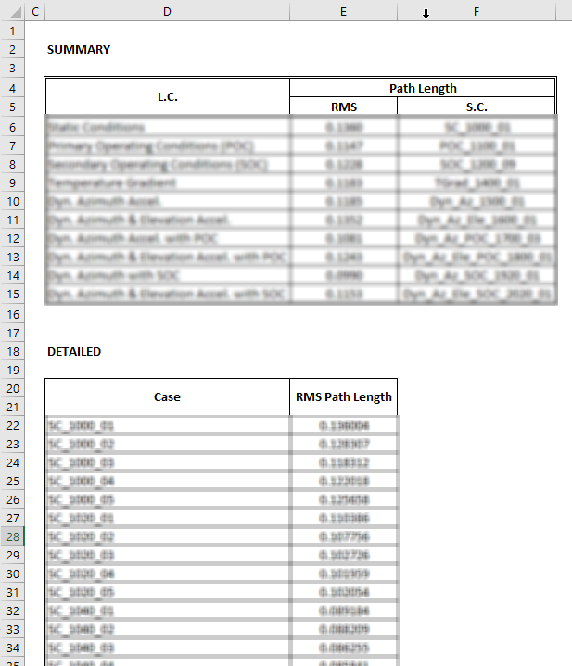
Example 1
Path Length calculation on an antenna dish
Path Length = (A_{i}+B_{i}+C) – (A_{i}'+B_{i}'+C')
B
A
C
Results sent to Excel
Over 230 cases
Multi angles
Different Operating Conditions
5BG .op2 file size
24 different paths
Notes:
Not the real antenna. Mention the confidentiality of this.
As soon as the client requested this, we knew that API was the way to approach it. Manually just not an option!!!
Benefits
Hours of repetitive and error prone manipulations from copying Femap Data Table to Excel.

Slide 19
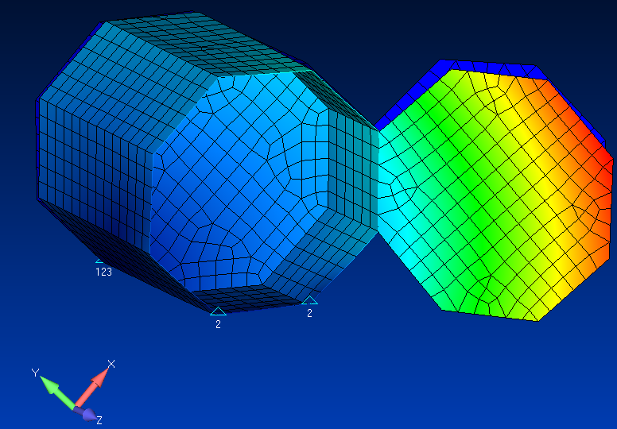
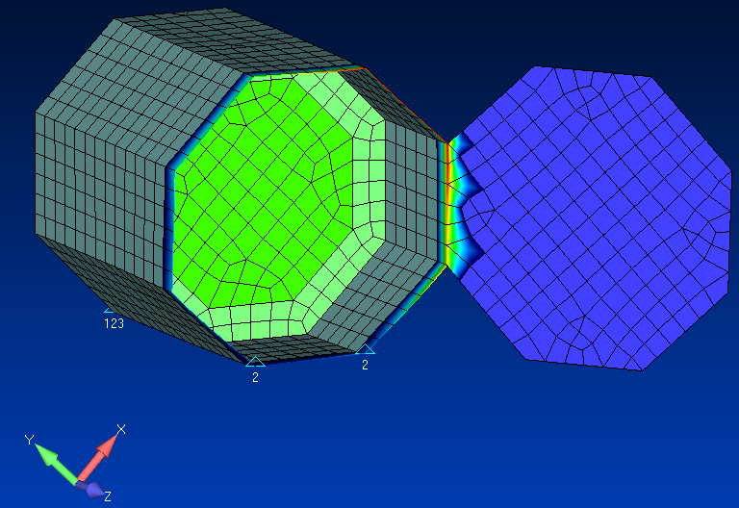
Example 2
Calculate in-plane displacements
"Fridge door" open panel case
In-plane displacement resultant calculated for nodes on door opening
Notes:
Not the real spacecraft. Mention the confidentiality of this.

Slide 20
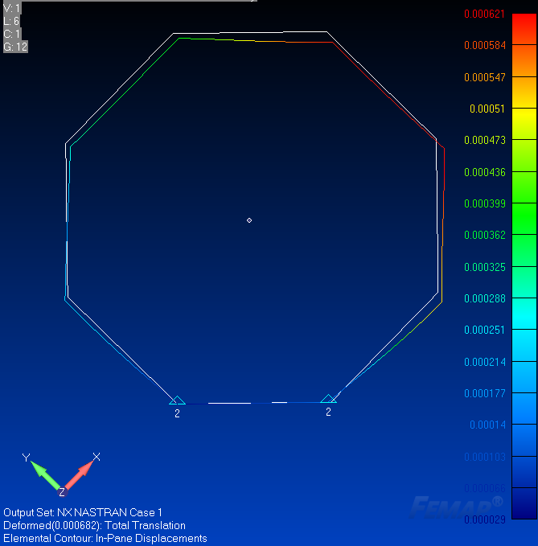
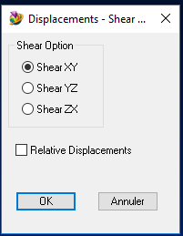
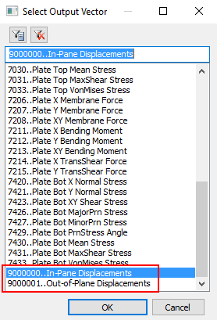
Example 2
Calculate in-plane displacements
1
4
2
3

Slide 21
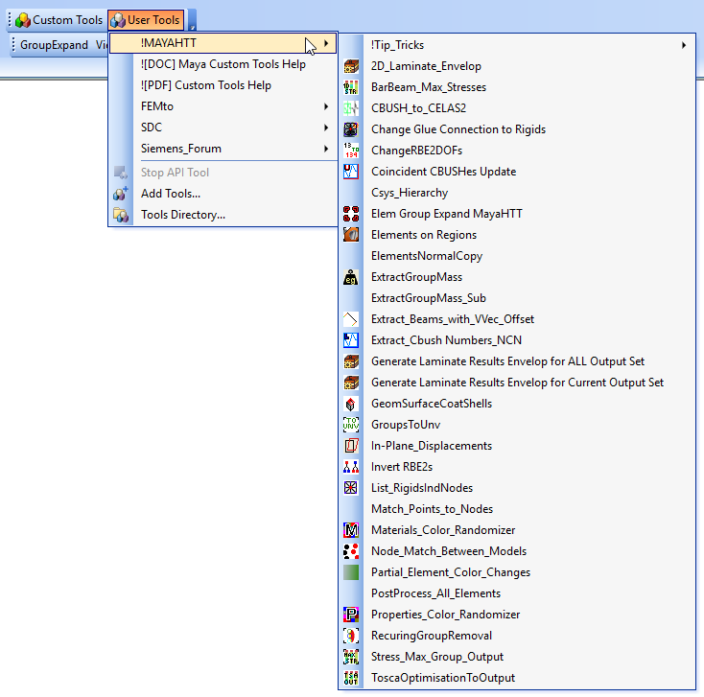
Maya User Tools
Notes:
Adjust the

Slide 22
Summary
API Overview vs Program File
Interface
Resources - Custom Tools
The API lets you customize FEMAP to meet your specific needs
3 day API training available
Notes:
To remember
→batch process from Excel
→result output creation, output to Femap or Excel
→save time, avoid manupulation errors

