Slide 1
Femap Thermal & Flow V11
Carl J. Poplawsky
Femap Symposium
Ann Arbor, MI.
June 4th, 2015

Slide 2
MAYA Company Overview
OEM Foundation Siemens PLM Partner 30+ years
Software Developer
Femap (Thermal, Flow, SAToolkit)
NX, I-deas, BuildIT, DC Clarity
Software Reseller
NX, Femap, LMS
Services Provider
Structural, Thermal/Flow, Femap/NX API, SW development, Training, Support
120+ Qualified Domain Experts
Advanced Degrees in Heat Transfer, CFD and Structural Analysis
Presence Across North America
Headquartered in Montreal
Offices in Dallas, Chicago, Phoenix

Slide 3
Femap Thermal & Flow
Siemens OEM Thermal and Flow solvers (developed by Maya) embedded into Femap
Not 3rd party software
No file translations
Single unambiguous user interface
No revision mismatch issues
NX Nastran
MSC.Nastran
NEi Nastran
Femap Thermal/Flow
LS-DYNA
Sinda
Adina
ANSYS
ABAQUS

Slide 4
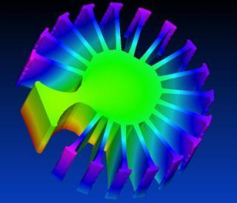
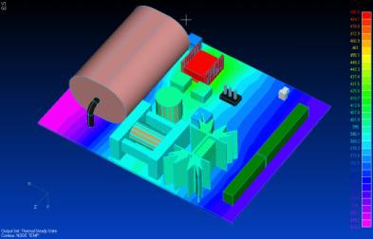
Femap Thermal
Comprehensive heat transfer simulation package
Steady state / transient
Conduction
Implicit convection
Thermal Couplings
Thermal Boundary Conditions
Radiation
Joule heating
Temperature mapping for structural
Notes:
Let’s now take more of a deep dive into Femap Thermal. Femap Thermal is a comprehensive heat transfer simulation package, providing both steady state and transient solutions. All facets of conduction are supported, along with implied convection (where the user defines heat transfer coefficient and gas temperature distributions) and other user defined thermal boundary conditions.
Radiation view factors (when required) along with shadowing are calculated concurrently with the thermal solution. Femap Thermal will also solve the joule heating electrical and thermal problem, with full multiphysics coupling.

Slide 5
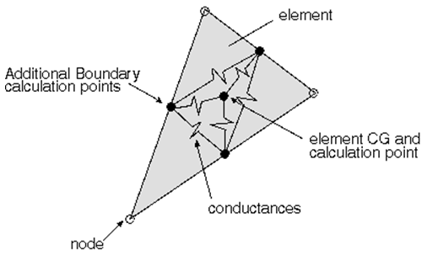
Femap Thermal Conduction
Finite elements for modeling but finite volume for the solution technique
Allows for use of all element types, including beams, shells, solid tetrahedral, and solid brick elements…even axi-symmetric and multi-layer shells!
Supports orthotropic and anisotropic material properties and phase change
Provides for nonlinear material properties, including temperature dependency
Notes:
Femap Thermal utilizes finite elements at the user level for ease of modeling, but actually establishes calculation points at the element centroids and edges for a finite volume solution. This provides a significant advantage in that the solver handles material nonlinearities much better, and numerically converges on physical entities instead of error functions.
All element types are supported, so that the most efficient element type is always available, providing for compact and economical models that solve quickly.
Directionally dependent material properties, common in everything from circuit boards to composite structures, are easily handled, as are nonlinear material properties, such as temperature dependency.

Slide 6
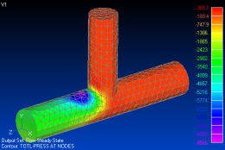
Femap Thermal Convection and Boundary Conditions
Convection can be defined using heat transfer coefficient and gas temperature distributions provided by the user
Includes the ability to read in 3rd party data files
When coupled to Femap Flow, convection is fully automated
Thermal boundary conditions include heat flow, heat flux, heat generation, temperature, and radiation
Thermal loads can be spatially mapped using the Femap data surface
Heat loads can be controlled by a thermostat or a P, PI, or PID controller
Notes:
When running Femap Thermal standalone (as in without Femap Flow) the user can define implied convection by providing heat transfer coefficient and gas temperature distributions, with capability to read in data files from 3rd party modeling tools. Of course when Thermal and Flow are fully coupled, convection boundary conditions are provided by the flow solver.
Heat flow along with area and volumetric heat flux is fully definable, and can be controlled with time-dependency, an On/OFF thermostat, or a proportional controller. All loads can be varied spatially using the Femap data surface.
If the user can determine radiation view factors via inspection (for instance 2 parallel plates within close proximity have a view factor of 1), radiation can be defined with a dedicated boundary condition entity, and is far less computationally intensive than the full view factor solution capability

Slide 7
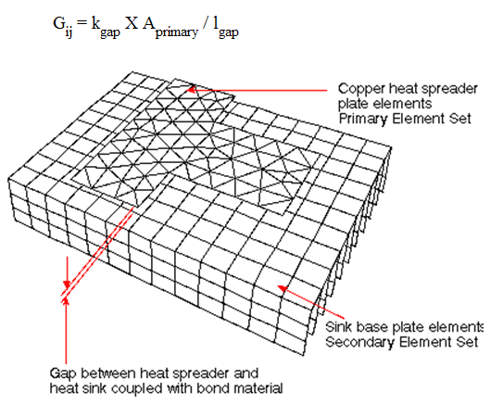
Femap Thermal – Thermal Couplings
Thermal couplings allow the user to thermally connect dissimilar meshes, with a conductance of any value
Bonded or bolted joints
Card edge guides
Semiconductor package “theta’s”
Also allows the user to greatly simplify the physical representation of an entity
Makes the meshing burden much lower since continuous meshes are not required
Notes:
Thermal couplings represent one of several major advantages of Femap Thermal over competing finite-element based thermal analyzers. Thermal couplings allow the user to define thermal conductances between multiple entities, regardless of mesh size and type. They also allow the user to greatly simplify the physical representation of an entity in the model. For instance, there is no need to mesh an adhesive layer, a card edge guide, or even define all the intricacies of a semiconductor thermal package.
Meshing efforts are greatly reduced too, since the user can avoid meshing many entities, and when defining conductances between meshes, continuous meshes or meshes with matching node locations or element types are not required.

Slide 8
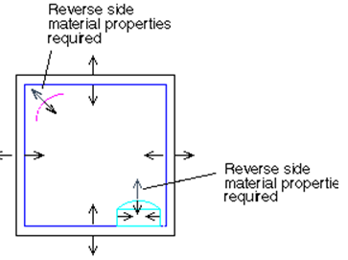
Femap Thermal Radiation
Allows for 2 bandwidths (typically thermal and solar), with different surface properties for each
Will detect enclosures, calculate view factors, perform shadowing checks, calculate diffuse and reflected radiative exchanges and compute radiative heating (if any) within the model
View factor algorithms include Hemicube, Deterministic, and Monte Carlo
Hemicube and Deterministic are supported for multi-processing
Notes:
Femap Thermal’s radiation modeler is bi-spectral, allowing for 2 bandwidths and their accompanying surface properties. The radiation problem solves concurrently with the thermal solve, and is capable of detecting radiation enclosures, calculating view factors with shadowing, and computing radiation conductances and their associated fluxes.
Three algorithms are provided. Hemicube uses the host machine OGL graphics card, and is very fast. Deterministic is a more traditional approach to view factor calculations, and Monte Carlo (which is used occaisonally in the space craft industry) is a physical based approach. Both Hemicube and Deterministic are fully parallelized, as is the actual thermal analyzer.

Slide 9
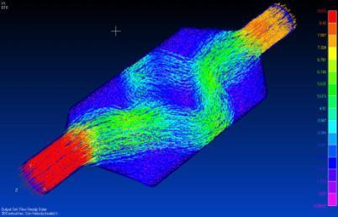
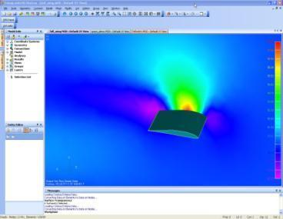
Femap Flow
Provides advanced computational fluid dynamics (CFD) capability used to determine the effects of fluid flow
Finite-volume solution technique
Fans and vents
Flow surfaces
Symmetry planes and periodicity
Screens and blockages
Rotating frame of reference
High speed flow
Pressure and shear load mapping
Notes:
Femap Flow is a full feature CFD tool that is easy to use, and well suited for flow design issues. Capable of performing either internal or external flow simulations, it can be used for anything from sizing a fan in an electronics box to predicting drag on a lifting body. It’s capable of both steady state and time-dependent solutions, and is good for high speed flow up to about Mach3. It benefits from the use of either solid 4-node tetrahedral elements for free meshing of irregular geometry, or solid 8-node brick elements.
Like Femap Thermal, the finite elements are used for modeling purposes but actually calculation points are established at nodes, for a finite volume solution. Femap Flow performs an exact solve for mass, momentum, and energy. The non-exact entity is the so-called wall function, which is the velocity distribution within the flow boundary layer. Maya developers have carefully chosen appropriate wall functions for each class of flow solutions.

Slide 10
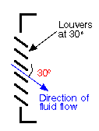
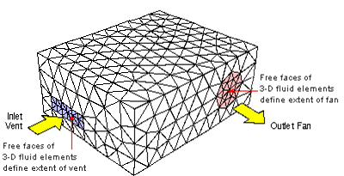
Femap Flow Fans and Vents
Allows the user to define air sources (fans)
Velocity, volumetric flow, mass flow, pressure rise, or fan curve
Fans can be at the flow boundary or embedded
A recirculating fan (closed loop) is also available with or without heating or heat removal
The user can include secondary effects
Fan swirl, motor heating, louvers, perforated inlet plates, etc.
Vents can be defined at the flow boundary
The software determines flow direction
The user can include secondary effects
Fan swirl, motor heating, louvers, perforated inlet plates, etc.
Notes:
Femap provides for multiple ways of defining air sources, or fans. Fans can be at the flow boundary, internal to the flow, or define a closed loop. The closed loop recirculating fan lets the user define heat gain or removal, to simulate an environmental control system.
Vents can be defined at the flow boundary, and the software will figure out which way they flow, based on pressure levels.
Both fans and vents allow the user to define secondary effects, including fan swirl, fan motor heating, and the head losses associated with louvered or perforated plates.

Slide 11
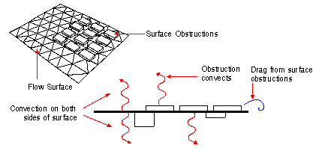
Femap Flow – Flow Surfaces
Allows the user to designate surfaces for convection and drag
The user can provide characteristic roughness
Or the software will calculate characteristic roughness given a set of “obstruction elements”
Femap also provides a setting for “auto-convecting” from all free surfaces
Notes:
Femap Flow provides flexibility when designating surfaces for convection and/or friction. The user can define a characteristic roughness, or the software will calculate one based on a set of obstruction elements. Obstruction elements are 2D shell elements that coat the top surface of any items attached to the surface. This is particularly useful when simulating circuit boards populated with components, where the fluid mesh need not conform to the components on the board, but only the board itself.
A time saving feature when all surfaces in a model have consistent surface properties is to use the “auto-convect” switch, where the software will define convection and friction on all free surfaces using default surface properties.

Slide 12
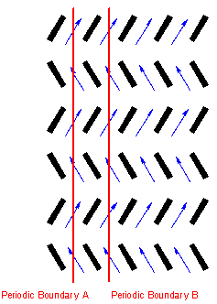
Femap Flow Symmetry Planes and Periodicity
Includes the ability to take advantage of both geometric and flow/thermal symmetry
Can significantly reduce the size of a model, and hence the solution run time
Flow symmetry planes
Forces the flow parallel to the plane with zero friction
Periodicity
Forces a mirror image of the flow from the source surfaces onto the slave surfaces
Notes:
Maya is very proud of the fact that most Femap CFD problems can be run on a typical Windows desktop or laptop computer, with only modest memory. One reason for this is the ability to take advantage of both geometric and flow / thermal symmetry. This is a very important feature because it can drastically reduce the size of a model, and hence its solution run time.
Flow symmetry planes force the flow to be parallel to a plane, with no friction effects. This is typically used for geometry half or quarter symmetry.
In contrast, the periodicity capability in Femap Flow forces a mirror image of the flow from a source surface onto a slave surface. This is particularly useful for bladed or repetitive geometry.

Slide 13
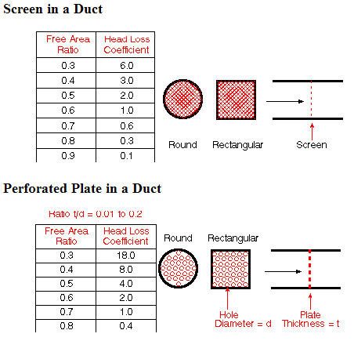
Femap Flow Screens and Blockages
Femap provides for head losses associated with entities that impede or block flow
Screens
Allow the user to define head loss factors for one or more surfaces
Very useful for screens, thin filters, perforated plates (such as EMI shields), etc.
Blockages
Allows for directional head loss factors defined in a 3D area
Useful for flow straighteners, porous media, bundles of wires, etc.
Notes:
In most cooling designs, there are items which impede flow. Femap Flow provides the flow entities necessary to simulate these items. Flow screens can be used for screens, thin filters, and even perforated plates…like EMI shields. The Femap documentation provides guidance on how to determine head loss factors given parameters like hole pitch and diameter.
Femap Flow also offers 3D flow blockages; either 100% blockages or porous flow blockages, where head loss per unit length can be defined in different directions. 3D blockages are good for large solid items that are not defined in the flow mesh, flow straighteners, porous media, or areas that are partially blocked with things like wiring bundles.

Slide 14
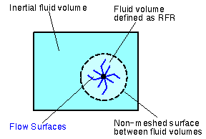
Femap Flow Rotating Frame of Reference, High Speed Flow, Mapping
Provides the ability to define a rotating frame of reference for rotationally dominant flows
Useful when analyzing rotating machinery (such as impellers, turbine blades, etc.)
Produces accurate results with far less computation
Solves high speed compressible flow to Mach 3
Mapping tool will interpolate pressure and shear loads onto dissimilar structural mesh
Notes:
Another technique included in Femap Flow to minimize model solution times is Rotating Frame of Reference. It’s a CFD technique that is useful when analyzing the impact of rotating machinery (such as impellers, turbine blades, etc.) on the surrounding fluid. Rather than attempting to perform an analysis of the moving machinery passing through the stationary fluid, a Rotating Frame of Reference is used to perform a steady state analysis where the rotating machinery is assumed to be stationary and the surrounding fluid is assumed to be rotating about the same axis in the opposite direction. The analysis measures the perturbations in the rotating flow as it passes around the stationary machinery, which produces similar results with far less computation.
Additionally, Femap Flow can solve high speed compressible flow problems up to about Mach 3.

Slide 15
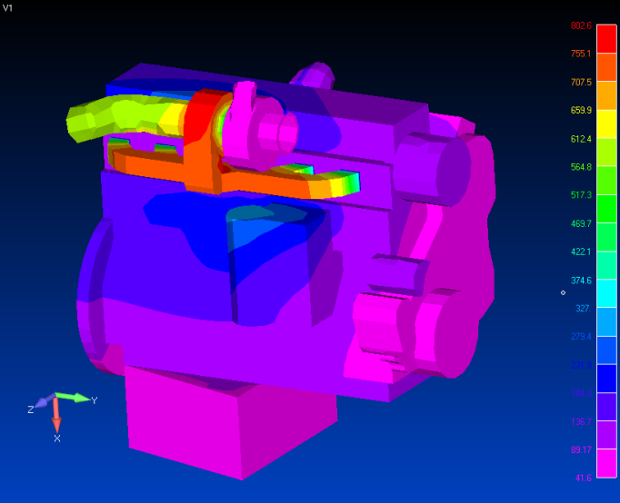
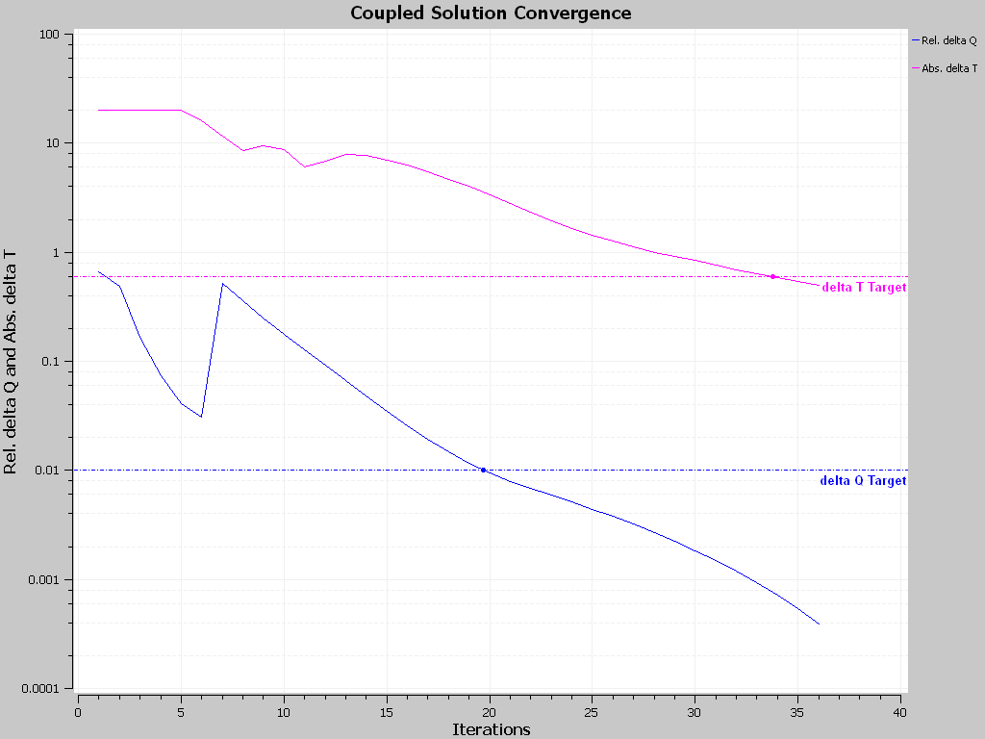
Fully Coupled Femap Thermal and Flow
Multiphysics
Multiple solvers interact (couple) with each other
The Femap Thermal and Flow Solvers are fully coupled
The conjugate heat transfer problem is handled automatically
Fluid temperatures and heat transfer coefficients
Wall heat fluxes
Useful for virtually any convection cooling or heating application, forced or free
Automotive
Electronics systems
Manufacturing
Etc.
Notes:
Multiphysics is the ability of multiple solvers to interact with each other. A good example of this is the ability of Femap Flow and Thermal to run fully coupled, passing off surface and fluid information between them. There is no longer any guess work in defining heat transfer coefficient and gas temperature distributions for thermal analysis, since the flow solver provides that information directly to the thermal solver. The thermal solver in turn passes heat flux information back to the flow solver. Both solvers run concurrently, and take advantage of the multi-CPU features available in todays computer hardware options. During the solution the user gets real-time XY plots showing all convergence characteristics, as well as a solution monitor that provides a summary of the current solution statistics and results. The value of this is that you know exactly what the solver is doing at all times, and can assess convergence characteristics in real time to either estimate completion time or to pause the solution to change solution parameters.

Slide 16
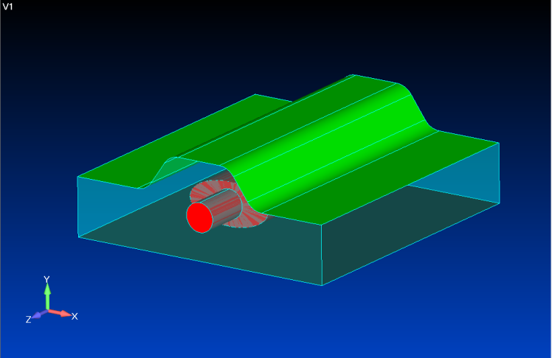
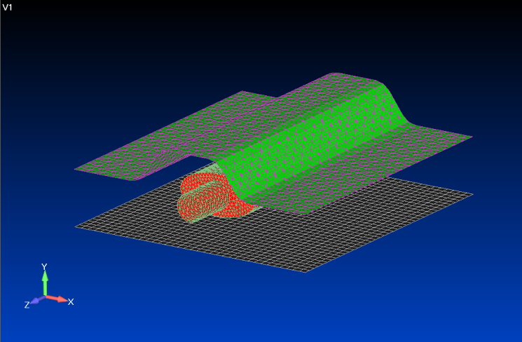
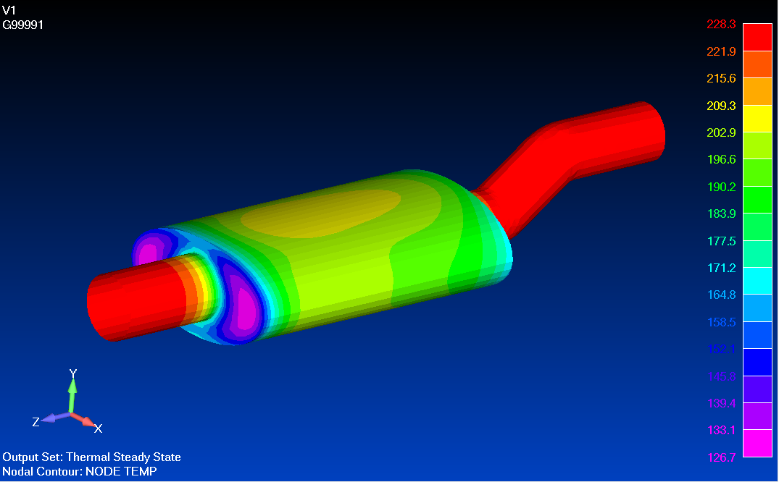
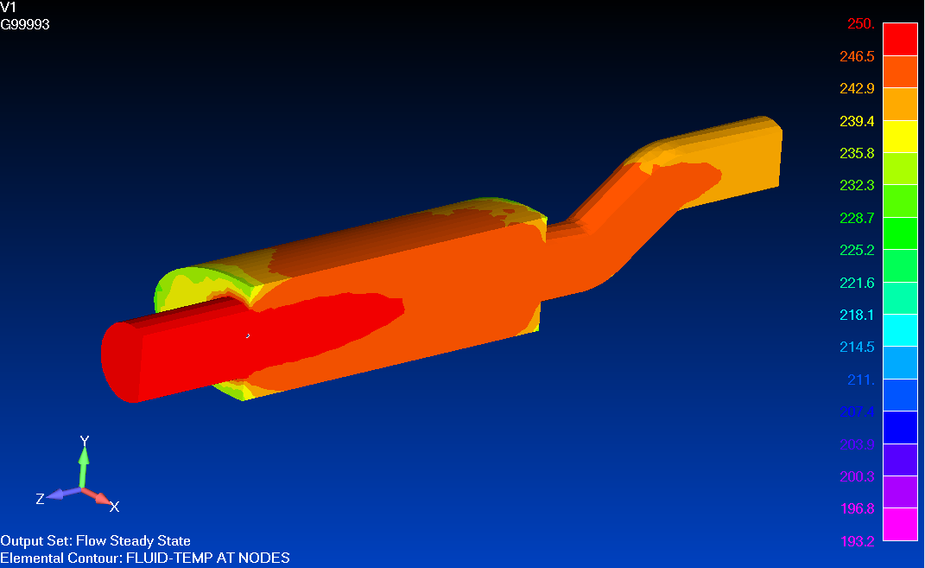
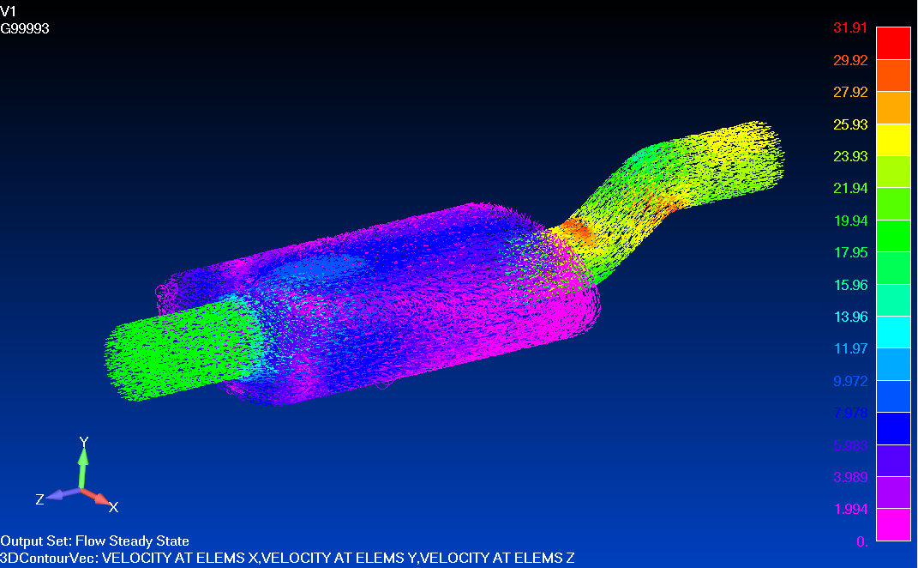
Femap Coupled Thermal / Flow Demonstration
Notes:
Let’s move on to our next demonstration. This demonstration will illustrate simulation of conduction, convection, a radiative heat source, and enclosure radiation in the kitchen oven application. We’ll apply free convective thermal boundary conditions on the oven exterior, and use a conductive thermal coupling to simulate thermal insulation between the inner and outer walls. We’ll also define the filament as a radiative heat source and have the software calculate enclosure radiation including view factors and shadowing inside the oven. Then we’ll solve using NX Thermal and wrap it up with some post-processing.

Slide 17
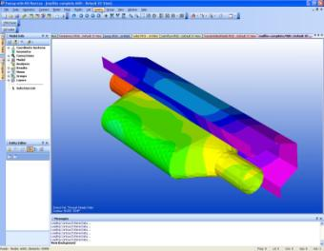
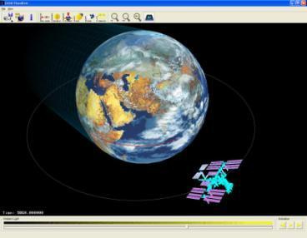
Femap Advanced Thermal
Advanced suite of thermal simulation
extensions to the Femap Thermal solver
Radiative Heating & Orbital Modeling
Duct Flow (1D fluid networks)
Convection Correlations
Notes:
Femap Advanced Thermal is an add-on to Femap Thermal, and provides thermal simulation extensions. This includes the ability to place the model in orbit about a planet or moon, and have the software calculate the position-dependent solar and IR fluxes. Also included is the ability to place a model on the surface of the earth or planet, and have the software calculate the time-dependent solar fluxes and shadowing effects.
Duct Flow is a 1D pipe element capability, where 3D wireframe is meshed with 1D pipe elements, and pressures, temperatures, and flow rates are calculated by the solver given user-defined boundary conditions. The software includes a collection of both internal and external flow textbook heat transfer coefficient correlations and provides for convection to the rest of the thermal model.
Temperatures would be of limited use if they could not be used in the structural model to calculate thermal stresses and deflections. Femap Advanced Thermal includes a mapping tool, which will interpolate temperature results onto a completely different structural mesh, and supports not only NX Nastran, but also other commercially available solvers. The tool will also allow the user to define target mapping set pairs, to prevent temperatures from mating items to be mistakenly mapped to the wrong entity.

Slide 18
Q & A
Find out more
www.mayasim.com
800 343 6292 (toll-free)
info@mayasim.com
Notes:
I appreciate your time today, and hope I have aroused your interest in either integrating Femap Thermal and Flow into your design process, or replacing your existing outdated legacy CAE tools. You can also find out more about Femap products on our website, or by calling or emailing Maya at the addresses shown on this slide.
Let’s open up the remaining few minutes to questions. Please un-mute your mic’s now.

